Slide 1
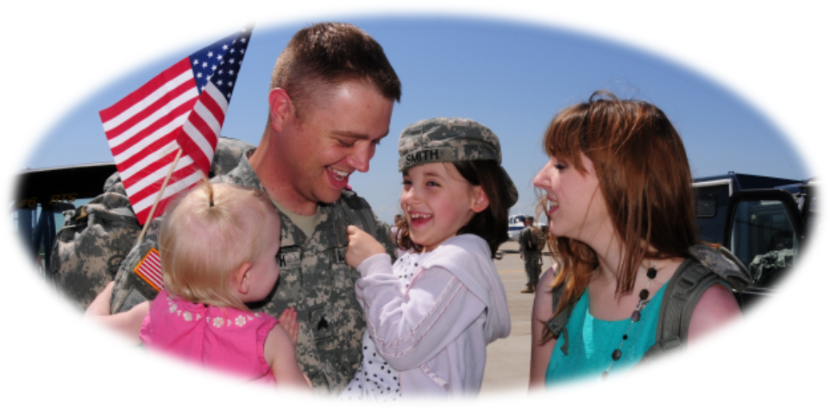
Understanding and Connecting with Service Members and Their Families
Dr. Grady Osten-Garner, Ret. Officer, USAR
MAJ Michell L. Griffith, Psy.D, MS, USA
Notes:
Introduction or Dr. Osten-Garner and myself- military history

Slide 2
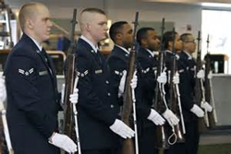
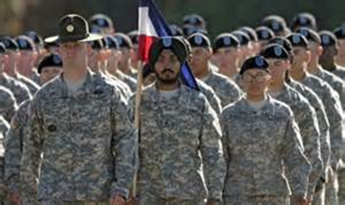
OBJECTIVES
Understanding who we are.
What motivates and governs us?
Understanding tours, deployments and reunification
How it impacts the Service Member, Families, and possibly YOU (the civilian provider) and therapy sessions.
Possible Landmines and Strengths of Civilian Providers.
What may be expected from you in terms of Confidentiality?
Understanding the impact of misdiagnosing and MED Boards.
Community and DoD resources.

Slide 3
BASIC INFORMATION
Military has 7 Divisions: US Army, US Navy, US Marines, US Air Force, US Coast Guard, Public Health Services, and National Oceanic and Atmospheric Admin (NOAA).
National Guard and Reserves.
Estimated 3.6 million Service Members.
Army has largest AD (547,057).
Officer to Enlisted ration (1 to 4.8).
Women compose approximately 14.6% of DoD force.
(2012 demographics: Profile of Military Community – Military One Source Nov 2013)

Slide 4
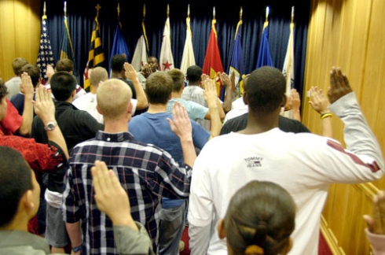
WHO JOINS THE MILITARY?
Individuals come from a variety of backgrounds.
Nearly ½ of Active duty (AD) force (48.8%) is under 25yrs old.
Over ½ of AD military members are married.
6.3% of military members are in dual military marriages.
36.8 % of members married with children.
7% of members single parents.
98% of enlisted have high school diploma; many have college degrees.
Standards for enlistment change based on the needs of the military- positive and negative consequences.
Notes:
One must remember needs of the military and waivers are possible if the need is great- especially during time of war. GED, legal issues, ASVAB scores, pre-existing medical conditions- age- all reflect current needs.

Slide 5
WHY JOIN THE MILITARY?
Housing Allowance
Money for Education
Medical/Dental Coverage
Life Insurance
VA Benefits after Retirement
Military Pension
Notes:
Housing: BAS and BAH if off post- non taxed
Medical and dental coverage (about 22 dollars and about 33 dollars for dental)
Life insurance (low cost for 400,000)
Retirement/ pension- depends on amount of time and rank (if married more than 10 years- ex spouse is entitled to a good percentage)
Base pay for E-1 w/o family= 1467.60 per month while in training- after= 2652 per month
Family traditions- get away from problems at home
See the world

Slide 6
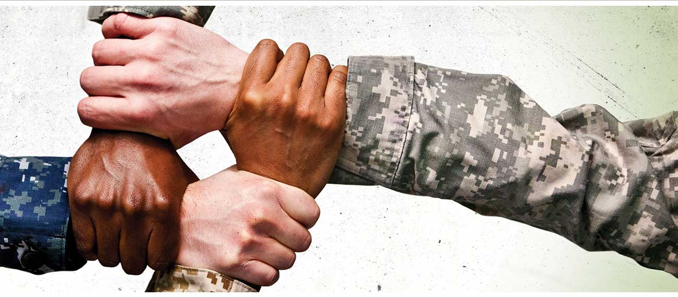
ESTABLISHING A MORAL COMPASS AND BELONGING
Oaths
Creeds
Uniform Code of Military Justice and Article 15
Higher Standards associated with wearing the uniform
Notes:
Administer the Oath of Enlistment- discuss UCMJ- enemies –domestic and foreign–
How we must hold to higher standards for order
Read creeds for branches-

Slide 7
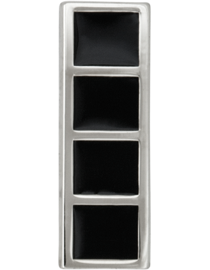
UNDERSTANDING PROMOTIONS
Warrant Officer
Expertise, Evaluations, Boards
Officer
TIS, Evaluations, Boards RIF
Enlisted
TIS, Evaluation, MOS Strength, Boards and Testing
Notes:
Depends on branches- tests-boards- etc
Discuss what stressors there are when one is passed over for promotion- Time in rate
3. Officers- how we are promoted-
All numbers based on needs of military

Slide 8
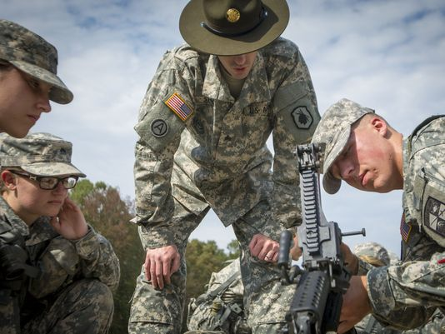
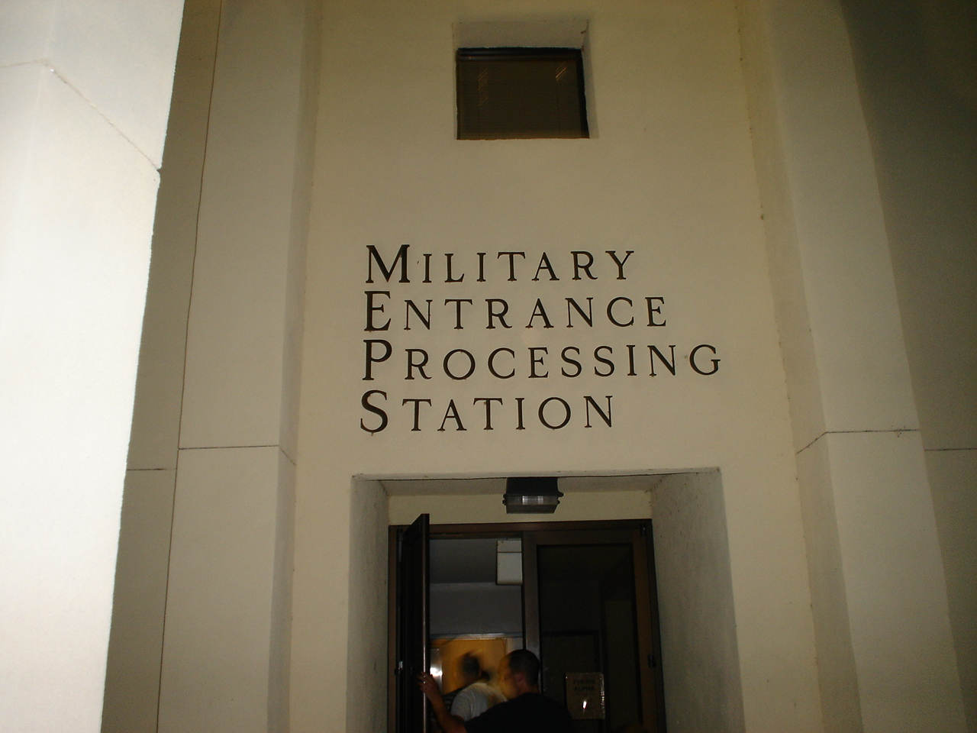
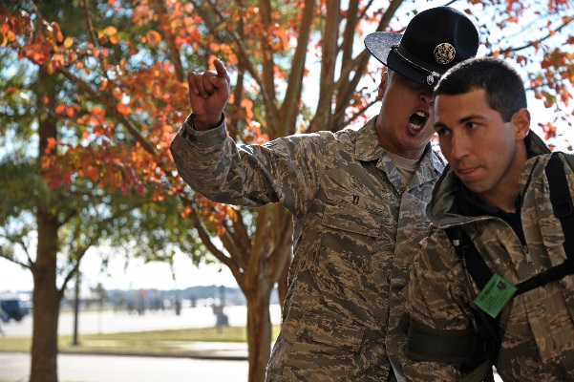
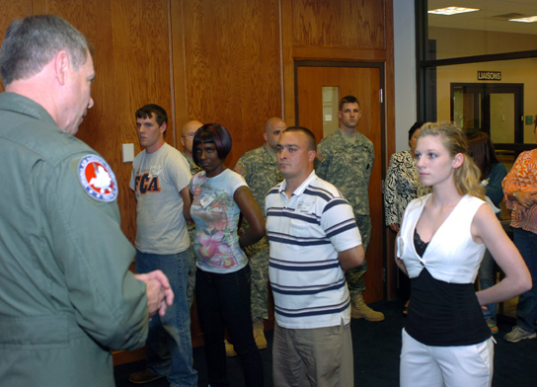
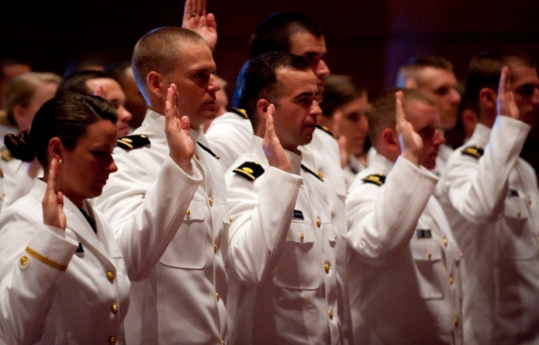
BECOMING A “MILITARY MEMEBR”
Recruitment
Armed Services Vocational Aptitude Battery Test (ASVAB)
Determines job placement
Physicals
Background Checks
Basic Training- Branch specific training
One Station Unit Training (OSUT)
Advanced Individual Training
Military Occupational Specialty training (Job Training)
Officer Basic Training
Warrant Officer Candidate School
Notes:
All branches differ in basic training requirements. Bottom line up front (BLUF)- prepare for individual training and first duty station

Slide 9
CHALLENGES GOING FROM “CIVILIAN” TO “SERVICE MEMBER”
Relationship problems stemming prior to joining service
Young age (18-24) and background history
Isolation from primary support and family of origin
Responsibility
Chain of Command- you answer to everyone above you in rank
Don’t necessarily understand need for military discipline
Ex. Why do I have to be awake at 0500 if we don’t have formation until 0700… Hurry up and wait…..
Ex. Why do I have to stand a certain way for this person…..
Notes:
New culture- all volunteer force.
Going from big fish in small pond to small fish in big pond-
Generation changes- less physically active- less personal connection skills-

Slide 10
Loyalty, Duty, Respect, Selfless Service, Honor, Integrity, and Personal Courage
Since 2001- about 2.5 Million US Troops have deployed to Iraq and Afghanistan.
Of those, more than a third were deployed more than once.
Nearly 37,000 Americans had been deployed more than 5 times.
Records indicate that 400,000 service members have done three or more deployments.
Deployment cycles differ for different branches
(http://amarillo.com/news/latest-news/2013-03-19/25-million-went-war-iraq-and-afghanistan-many-returned-lifelong-scars)

Slide 11
COMMON STRESSORS FOR “ESTABILISED” MILITARY MEMBERS
Deployments
Temporary Duty
The melting pot of Service Members
Fitness for Duty
Permanent Change of Station (PCS)
Expectations
Notes:
deployments- 15 months- 9 months- 6 months- all depends on branch of service-
Temporary duty – away from family
Different backgrounds/ expectations for melting pot
If not found fit for duty- can be medboarded out of the military
Expectations- pass pt test or no favorable actions

Slide 12
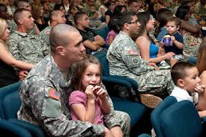
FAMILY CONCERNS
50% of Service Members are married (pros and cons)- financial gains- yet younger age at time of marriage and when starting a family
Bases away from family of origin –possibly different country
Family members must be resilient and adapt to new environment/ culture
Education levels at duty station (varies from state to state)
Impacts where to live and if children and spouse moves with them
Spouses “give up” careers to move every 2-3 years
Financial difficulties if spouse can’t find employment
Notes:
(SHOW SLIDE #2) Vignette “Human Dynamics”
Narrative:
Facilitator Note: Have students discuss small group observations about the Stanford Prison Experiment video
Questions to keep in mind:
How did the video make you feel?
What similarities are there between the Prison Project and the IMT Environment?
Allow the students:
10 Minute Discussion Small Group
5 Minute Large Group Close-Out
Facilitator Note: Break the class down into Small Groups. Have each member of the group discuss their observations about the Stanford Prison Project video, with the focus of linking positions of power and the abuse of power within organizations. Students should be able to identify the similarities between the prison guards and the prisoners in the video. Students can do this by identifying the similarities of power and authority given to each Cadre member over a trainee by position (If students cannot determine similarities, provide them with examples such as Cadre having the power over trainees). Discuss how the video made members of the group feel and why. Consolidate group findings and designate a representative to present the groups findings to the class. Each group will take no more than three minutes to share each group’s feedback.

Slide 13
MORE THINGS TO CONSIDER
High Rates of Depression and Anxiety in Spouses
Extended Separation
Rising Rates of Suicide
PTSD
Constant Pull of Military and Family Duties
Transitions to and From Deployment
Notes:
(SHOW SLIDE #2) Vignette “Human Dynamics”
Narrative:
Facilitator Note: Have students discuss small group observations about the Stanford Prison Experiment video
Questions to keep in mind:
How did the video make you feel?
What similarities are there between the Prison Project and the IMT Environment?
Allow the students:
10 Minute Discussion Small Group
5 Minute Large Group Close-Out
Facilitator Note: Break the class down into Small Groups. Have each member of the group discuss their observations about the Stanford Prison Project video, with the focus of linking positions of power and the abuse of power within organizations. Students should be able to identify the similarities between the prison guards and the prisoners in the video. Students can do this by identifying the similarities of power and authority given to each Cadre member over a trainee by position (If students cannot determine similarities, provide them with examples such as Cadre having the power over trainees). Discuss how the video made members of the group feel and why. Consolidate group findings and designate a representative to present the groups findings to the class. Each group will take no more than three minutes to share each group’s feedback.

Slide 14
STILL CONSIDERING….
SM Spouse left with Childcare Duties
Increase of Behavioral issues in Children
Financial Hardships
Job Security
Missed Milestones
Frequent Relocation
Notes:
(SHOW SLIDE #2) Vignette “Human Dynamics”
Narrative:
Facilitator Note: Have students discuss small group observations about the Stanford Prison Experiment video
Questions to keep in mind:
How did the video make you feel?
What similarities are there between the Prison Project and the IMT Environment?
Allow the students:
10 Minute Discussion Small Group
5 Minute Large Group Close-Out
Facilitator Note: Break the class down into Small Groups. Have each member of the group discuss their observations about the Stanford Prison Project video, with the focus of linking positions of power and the abuse of power within organizations. Students should be able to identify the similarities between the prison guards and the prisoners in the video. Students can do this by identifying the similarities of power and authority given to each Cadre member over a trainee by position (If students cannot determine similarities, provide them with examples such as Cadre having the power over trainees). Discuss how the video made members of the group feel and why. Consolidate group findings and designate a representative to present the groups findings to the class. Each group will take no more than three minutes to share each group’s feedback.

Slide 15
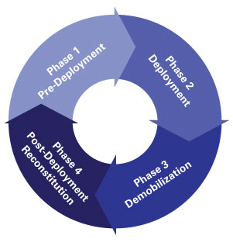
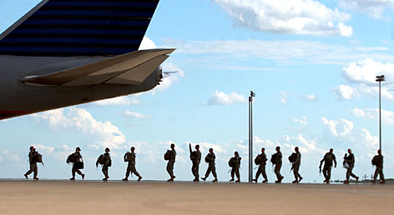
DEPLOYMENT BEFORE, DURING AND AFTER…
Pre Deployment “train up” Impact on Service Member and Families
More verbal arguments, pushing away –disengaging
Who are they deploying with
Individually or with their unit
Family Readiness Group (FRG) role
Understand frustration of “not knowing details”!!!!!!
Operational Security
Questions to consider
Who are key support for family/ spouse?
Are spouse and kids moving back “home”?
How to prepare kids? (age appropriate)
Notes:
(SHOW SLIDE #2) Vignette “Human Dynamics”
Narrative:
Facilitator Note: Have students discuss small group observations about the Stanford Prison Experiment video
Questions to keep in mind:
How did the video make you feel?
What similarities are there between the Prison Project and the IMT Environment?
Allow the students:
10 Minute Discussion Small Group
5 Minute Large Group Close-Out
Facilitator Note: Break the class down into Small Groups. Have each member of the group discuss their observations about the Stanford Prison Project video, with the focus of linking positions of power and the abuse of power within organizations. Students should be able to identify the similarities between the prison guards and the prisoners in the video. Students can do this by identifying the similarities of power and authority given to each Cadre member over a trainee by position (If students cannot determine similarities, provide them with examples such as Cadre having the power over trainees). Discuss how the video made members of the group feel and why. Consolidate group findings and designate a representative to present the groups findings to the class. Each group will take no more than three minutes to share each group’s feedback.

Slide 16
TOP CONCERNS FOR DEPLOYED SERVICE MEMEBRS
Home Front Issues/ Communication
Peer/Leadership Relationships
Fear of the Unknown
Exposure to Combat
Notes:
Interestingly- those who only deployed 1-2 times are at a great risk for suicide.

Slide 17
DEPLOYED
Operational Security
What can share with my loved ones?
Communication with Family
Can be Too Little or Too Much
Traumatic Experiences
Mortar Attacks, IEDs, Loss of Friends
Team Building Joint Forces
Sister Units
Individual Deployers
Deployment
DEPLOYMENT
Moral Dilemmas
World Views Change
Freedom From Life Responsibilities
Cooking, Laundry, Yard work
Notes:
(SHOW SLIDE #2) Vignette “Human Dynamics”
Narrative:
Facilitator Note: Have students discuss small group observations about the Stanford Prison Experiment video
Questions to keep in mind:
How did the video make you feel?
What similarities are there between the Prison Project and the IMT Environment?
Allow the students:
10 Minute Discussion Small Group
5 Minute Large Group Close-Out
Facilitator Note: Break the class down into Small Groups. Have each member of the group discuss their observations about the Stanford Prison Project video, with the focus of linking positions of power and the abuse of power within organizations. Students should be able to identify the similarities between the prison guards and the prisoners in the video. Students can do this by identifying the similarities of power and authority given to each Cadre member over a trainee by position (If students cannot determine similarities, provide them with examples such as Cadre having the power over trainees). Discuss how the video made members of the group feel and why. Consolidate group findings and designate a representative to present the groups findings to the class. Each group will take no more than three minutes to share each group’s feedback.

Slide 18
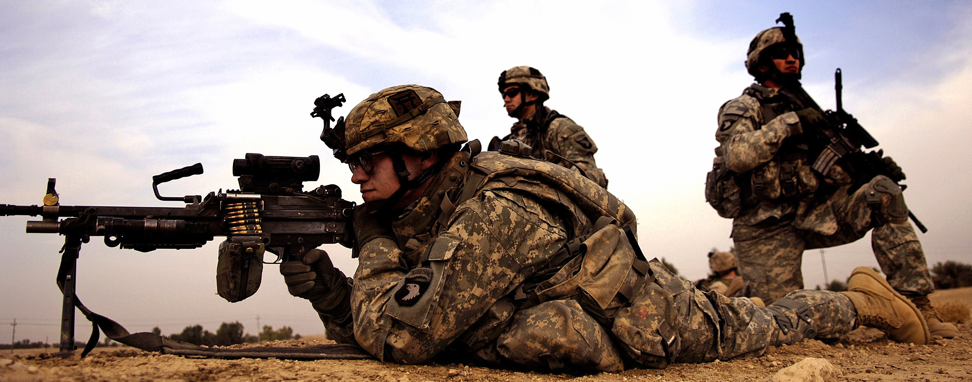
NORMAL FOR DEPLOYMENT SERVICE MEMBER
Highly focused; all or nothing thinking
React vs Think in dangerous situations
Trust in battle buddies
Control the environment
Purpose -This is what we train for
Limited sleep
Accepting one’s mortality. My buddies would be willing to die for me and I will be willing to die to protect them
Notes:
(SHOW SLIDE #2) Vignette “Human Dynamics”
Narrative:
Facilitator Note: Have students discuss small group observations about the Stanford Prison Experiment video
Questions to keep in mind:
How did the video make you feel?
What similarities are there between the Prison Project and the IMT Environment?
Allow the students:
10 Minute Discussion Small Group
5 Minute Large Group Close-Out
Facilitator Note: Break the class down into Small Groups. Have each member of the group discuss their observations about the Stanford Prison Project video, with the focus of linking positions of power and the abuse of power within organizations. Students should be able to identify the similarities between the prison guards and the prisoners in the video. Students can do this by identifying the similarities of power and authority given to each Cadre member over a trainee by position (If students cannot determine similarities, provide them with examples such as Cadre having the power over trainees). Discuss how the video made members of the group feel and why. Consolidate group findings and designate a representative to present the groups findings to the class. Each group will take no more than three minutes to share each group’s feedback.

Slide 19
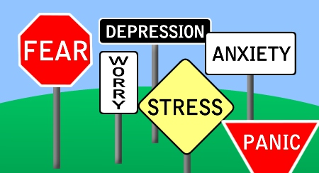
POST DEPLOYMENT SERVICE MEMBER
Unfocused-Anxiety
Upset over what we perceive as trivial tasks- No purpose
Loss of Control
Overwhelmed by daily tasks
Who can I trust- Who understands what I went through?
Spoiled and ungrateful Americans- take 10-15 minute showers… wasteful when others are starving…etc.
Reacting to sights, sounds, smells, and the little voice of uncertainty.
SLEEP ISSUES!
Notes:
(SHOW SLIDE #2) Vignette “Human Dynamics”
Narrative:
Facilitator Note: Have students discuss small group observations about the Stanford Prison Experiment video
Questions to keep in mind:
How did the video make you feel?
What similarities are there between the Prison Project and the IMT Environment?
Allow the students:
10 Minute Discussion Small Group
5 Minute Large Group Close-Out
Facilitator Note: Break the class down into Small Groups. Have each member of the group discuss their observations about the Stanford Prison Project video, with the focus of linking positions of power and the abuse of power within organizations. Students should be able to identify the similarities between the prison guards and the prisoners in the video. Students can do this by identifying the similarities of power and authority given to each Cadre member over a trainee by position (If students cannot determine similarities, provide them with examples such as Cadre having the power over trainees). Discuss how the video made members of the group feel and why. Consolidate group findings and designate a representative to present the groups findings to the class. Each group will take no more than three minutes to share each group’s feedback.

Slide 20
POST DEPLOYMENT SERVICE MEMBER continued.
Feeling like they no longer fit into their families due to the family changes that occurred in their absence, including the normative development and maturation of children and the increased competence of the spouse who has taken over many of the tasks and roles that were previously completed by the service member.
A feeling of separation for returning service members from the culture to which they return. Several reasons were cited such as lack of respect from civilians (including a loss of status and self-esteem), the belief that they hold themselves to a higher standard than civilians, and the complexity of “normal” life.
Difficulties related to interpersonal interactions (including those with their partners and children) due to low frustration tolerance, poor anger management, difficulties in coping and self-regulation, hyper vigilance, and social withdrawal.
https://www.ncfr.org/ncfr-report/focus/military-families/returning-home
Notes:
(SHOW SLIDE #2) Vignette “Human Dynamics”
Narrative:
Facilitator Note: Have students discuss small group observations about the Stanford Prison Experiment video
Questions to keep in mind:
How did the video make you feel?
What similarities are there between the Prison Project and the IMT Environment?
Allow the students:
10 Minute Discussion Small Group
5 Minute Large Group Close-Out
Facilitator Note: Break the class down into Small Groups. Have each member of the group discuss their observations about the Stanford Prison Project video, with the focus of linking positions of power and the abuse of power within organizations. Students should be able to identify the similarities between the prison guards and the prisoners in the video. Students can do this by identifying the similarities of power and authority given to each Cadre member over a trainee by position (If students cannot determine similarities, provide them with examples such as Cadre having the power over trainees). Discuss how the video made members of the group feel and why. Consolidate group findings and designate a representative to present the groups findings to the class. Each group will take no more than three minutes to share each group’s feedback.

Slide 21
PRE-DEPLOYMENT FAMILY CONSIDERATIONS
Long hours due to training and possible TDY for deployment training
Making sure legal and financial issues are taken care of/ updated
Quality vs Quantity of time spent together
Medical and dental appointments all up to date
Last minute visits interrupt plans
Family care plans for Single Parents
Notes:
(SHOW SLIDE #2) Vignette “Human Dynamics”
Narrative:
Facilitator Note: Have students discuss small group observations about the Stanford Prison Experiment video
Questions to keep in mind:
How did the video make you feel?
What similarities are there between the Prison Project and the IMT Environment?
Allow the students:
10 Minute Discussion Small Group
5 Minute Large Group Close-Out
Facilitator Note: Break the class down into Small Groups. Have each member of the group discuss their observations about the Stanford Prison Project video, with the focus of linking positions of power and the abuse of power within organizations. Students should be able to identify the similarities between the prison guards and the prisoners in the video. Students can do this by identifying the similarities of power and authority given to each Cadre member over a trainee by position (If students cannot determine similarities, provide them with examples such as Cadre having the power over trainees). Discuss how the video made members of the group feel and why. Consolidate group findings and designate a representative to present the groups findings to the class. Each group will take no more than three minutes to share each group’s feedback.

Slide 22
DURING DEPLOYMENTS FAMILY CONSIDERATIONS
Establish new routines and taking on additional responsibilities
Changes in school behavior
Sadness and
depression
Fear something bad will happen to the deployed parent
Media coverage impacts fears and misunderstandings
Correlation between parent at home and child’s overall wellbeing
http://www.nccp.org/publications/pub_938.html
Notes:
(SHOW SLIDE #2) Vignette “Human Dynamics”
Narrative:
Facilitator Note: Have students discuss small group observations about the Stanford Prison Experiment video
Questions to keep in mind:
How did the video make you feel?
What similarities are there between the Prison Project and the IMT Environment?
Allow the students:
10 Minute Discussion Small Group
5 Minute Large Group Close-Out
Facilitator Note: Break the class down into Small Groups. Have each member of the group discuss their observations about the Stanford Prison Project video, with the focus of linking positions of power and the abuse of power within organizations. Students should be able to identify the similarities between the prison guards and the prisoners in the video. Students can do this by identifying the similarities of power and authority given to each Cadre member over a trainee by position (If students cannot determine similarities, provide them with examples such as Cadre having the power over trainees). Discuss how the video made members of the group feel and why. Consolidate group findings and designate a representative to present the groups findings to the class. Each group will take no more than three minutes to share each group’s feedback.

Slide 23
SUSTAINMENT
Working as a team
Not as overwhelmed
“We got this”
Support systems well in place
Notes:
(SHOW SLIDE #2) Vignette “Human Dynamics”
Narrative:
Facilitator Note: Have students discuss small group observations about the Stanford Prison Experiment video
Questions to keep in mind:
How did the video make you feel?
What similarities are there between the Prison Project and the IMT Environment?
Allow the students:
10 Minute Discussion Small Group
5 Minute Large Group Close-Out
Facilitator Note: Break the class down into Small Groups. Have each member of the group discuss their observations about the Stanford Prison Project video, with the focus of linking positions of power and the abuse of power within organizations. Students should be able to identify the similarities between the prison guards and the prisoners in the video. Students can do this by identifying the similarities of power and authority given to each Cadre member over a trainee by position (If students cannot determine similarities, provide them with examples such as Cadre having the power over trainees). Discuss how the video made members of the group feel and why. Consolidate group findings and designate a representative to present the groups findings to the class. Each group will take no more than three minutes to share each group’s feedback.

Slide 24
POST DEPLOYMENT FAMILY CONSIDERATIONS
Honeymoon phase
30 to 60 days fun, happy, joyous
Back to work
45 to 60 days early mornings, grocery lists, mood swings.
Balancing raising children
School events, rocking the boat, do I need help?
Anxiety, field training, late hours at work.
Preparing for next deployment
Notes:
(SHOW SLIDE #2) Vignette “Human Dynamics”
Narrative:
Facilitator Note: Have students discuss small group observations about the Stanford Prison Experiment video
Questions to keep in mind:
How did the video make you feel?
What similarities are there between the Prison Project and the IMT Environment?
Allow the students:
10 Minute Discussion Small Group
5 Minute Large Group Close-Out
Facilitator Note: Break the class down into Small Groups. Have each member of the group discuss their observations about the Stanford Prison Project video, with the focus of linking positions of power and the abuse of power within organizations. Students should be able to identify the similarities between the prison guards and the prisoners in the video. Students can do this by identifying the similarities of power and authority given to each Cadre member over a trainee by position (If students cannot determine similarities, provide them with examples such as Cadre having the power over trainees). Discuss how the video made members of the group feel and why. Consolidate group findings and designate a representative to present the groups findings to the class. Each group will take no more than three minutes to share each group’s feedback.

Slide 25
Post-DEPLOYMENT FAMILY
Spouse
Not the only boss
Divide responsibilities
Children
Why that way??
I am grown now!!!
If injured
Wounded Warrior Program
Relocation???
Notes:
(SHOW SLIDE #2) Vignette “Human Dynamics”
Narrative:
Facilitator Note: Have students discuss small group observations about the Stanford Prison Experiment video
Questions to keep in mind:
How did the video make you feel?
What similarities are there between the Prison Project and the IMT Environment?
Allow the students:
10 Minute Discussion Small Group
5 Minute Large Group Close-Out
Facilitator Note: Break the class down into Small Groups. Have each member of the group discuss their observations about the Stanford Prison Project video, with the focus of linking positions of power and the abuse of power within organizations. Students should be able to identify the similarities between the prison guards and the prisoners in the video. Students can do this by identifying the similarities of power and authority given to each Cadre member over a trainee by position (If students cannot determine similarities, provide them with examples such as Cadre having the power over trainees). Discuss how the video made members of the group feel and why. Consolidate group findings and designate a representative to present the groups findings to the class. Each group will take no more than three minutes to share each group’s feedback.

Slide 26
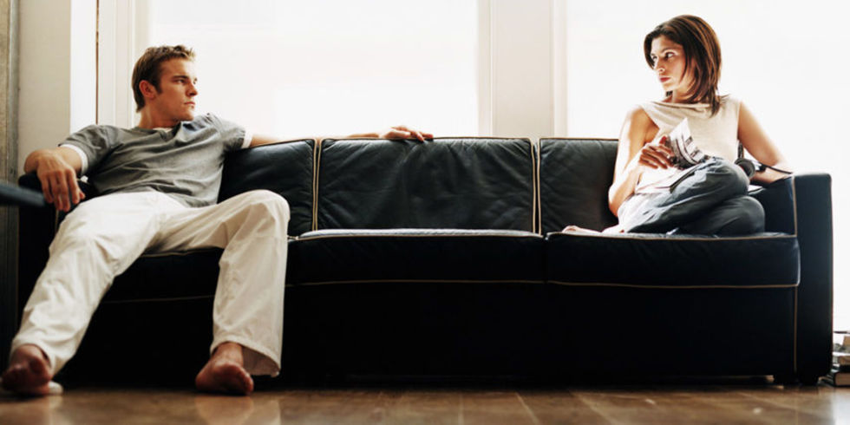
NEGATIVE CONDITIONS WITH REINTEGRATION
No Communication
Family Distorted
Misguided expectations
Combat Stress
https://www.ncfr.org/ncfr-report/focus/military-families/returning-home
Notes:
(SHOW SLIDE #2) Vignette “Human Dynamics”
Narrative:
Facilitator Note: Have students discuss small group observations about the Stanford Prison Experiment video
Questions to keep in mind:
How did the video make you feel?
What similarities are there between the Prison Project and the IMT Environment?
Allow the students:
10 Minute Discussion Small Group
5 Minute Large Group Close-Out
Facilitator Note: Break the class down into Small Groups. Have each member of the group discuss their observations about the Stanford Prison Project video, with the focus of linking positions of power and the abuse of power within organizations. Students should be able to identify the similarities between the prison guards and the prisoners in the video. Students can do this by identifying the similarities of power and authority given to each Cadre member over a trainee by position (If students cannot determine similarities, provide them with examples such as Cadre having the power over trainees). Discuss how the video made members of the group feel and why. Consolidate group findings and designate a representative to present the groups findings to the class. Each group will take no more than three minutes to share each group’s feedback.

Slide 27
Potential Negative Outcomes
Infidelity (possibly both parties) during all phases of deployment.
Those in the “rear detachment” are usually friends and infidelity is a betrayal- you were there to protect my spouse and you didn’t deploy
Encourage legal representation
Military justice- paychecks can be garnished to give unfaithful spouse money – percentage of BAH
Power of attorney issues -Special vs General Power of Attorney
Spouse has power while SM is deployed- bank account empty, car sold, bills not paid etc.
Command Involvement-especially if SM was unfaithful during deployment
Possible UCMJ action and dishonorable discharge
Notes:
(SHOW SLIDE #2) Vignette “Human Dynamics”
Narrative:
Facilitator Note: Have students discuss small group observations about the Stanford Prison Experiment video
Questions to keep in mind:
How did the video make you feel?
What similarities are there between the Prison Project and the IMT Environment?
Allow the students:
10 Minute Discussion Small Group
5 Minute Large Group Close-Out
Facilitator Note: Break the class down into Small Groups. Have each member of the group discuss their observations about the Stanford Prison Project video, with the focus of linking positions of power and the abuse of power within organizations. Students should be able to identify the similarities between the prison guards and the prisoners in the video. Students can do this by identifying the similarities of power and authority given to each Cadre member over a trainee by position (If students cannot determine similarities, provide them with examples such as Cadre having the power over trainees). Discuss how the video made members of the group feel and why. Consolidate group findings and designate a representative to present the groups findings to the class. Each group will take no more than three minutes to share each group’s feedback.

Slide 28
The Power of Commanders
Commanders can mandate no contact orders and remove weapons (if on post housing)
Can order ASAP or FAP involvement
Can order Service member to move back on Post
Can order 3822 and ignore recommendations
Promote or take rank
Flag individuals
However- most put their Soldiers needs first- to prevent negative outcomes

Slide 29
CONSIDERATIONS UPON OUTCOMES
PCS upon redeploying
Loss of peer support- Reservists
Ineffective coping skills
ETOH
Thrill seeking
If SM returned early due to injury or other issues- GUILT!!!
Notes:
(SHOW SLIDE #2) Vignette “Human Dynamics”
Narrative:
Facilitator Note: Have students discuss small group observations about the Stanford Prison Experiment video
Questions to keep in mind:
How did the video make you feel?
What similarities are there between the Prison Project and the IMT Environment?
Allow the students:
10 Minute Discussion Small Group
5 Minute Large Group Close-Out
Facilitator Note: Break the class down into Small Groups. Have each member of the group discuss their observations about the Stanford Prison Project video, with the focus of linking positions of power and the abuse of power within organizations. Students should be able to identify the similarities between the prison guards and the prisoners in the video. Students can do this by identifying the similarities of power and authority given to each Cadre member over a trainee by position (If students cannot determine similarities, provide them with examples such as Cadre having the power over trainees). Discuss how the video made members of the group feel and why. Consolidate group findings and designate a representative to present the groups findings to the class. Each group will take no more than three minutes to share each group’s feedback.

Slide 30
IMPACT OF DEPLOYMENT OF CHILDREN’S MENTAL HEALTH POST DEPLOYEMT
No longer the man of the house…
Age and developmental limitations
Fear parents won’t get along
Fear parents will leave again
Possible limited trust when parent leaves to go to work
“they won’t come back”
http://www.nccp.org/publications/pub_938.html
Notes:
(SHOW SLIDE #2) Vignette “Human Dynamics”
Narrative:
Facilitator Note: Have students discuss small group observations about the Stanford Prison Experiment video
Questions to keep in mind:
How did the video make you feel?
What similarities are there between the Prison Project and the IMT Environment?
Allow the students:
10 Minute Discussion Small Group
5 Minute Large Group Close-Out
Facilitator Note: Break the class down into Small Groups. Have each member of the group discuss their observations about the Stanford Prison Project video, with the focus of linking positions of power and the abuse of power within organizations. Students should be able to identify the similarities between the prison guards and the prisoners in the video. Students can do this by identifying the similarities of power and authority given to each Cadre member over a trainee by position (If students cannot determine similarities, provide them with examples such as Cadre having the power over trainees). Discuss how the video made members of the group feel and why. Consolidate group findings and designate a representative to present the groups findings to the class. Each group will take no more than three minutes to share each group’s feedback.

Slide 31
CHILDREN OF RESERVISTS CONSIDERATIONS
Isolated from Military Community
Peers, schools, neighbors often do not understand experiences
Parent may face unemployment
Isolated from resources
Lack of familiarity among providers
Notes:
(SHOW SLIDE #2) Vignette “Human Dynamics”
Narrative:
Facilitator Note: Have students discuss small group observations about the Stanford Prison Experiment video
Questions to keep in mind:
How did the video make you feel?
What similarities are there between the Prison Project and the IMT Environment?
Allow the students:
10 Minute Discussion Small Group
5 Minute Large Group Close-Out
Facilitator Note: Break the class down into Small Groups. Have each member of the group discuss their observations about the Stanford Prison Project video, with the focus of linking positions of power and the abuse of power within organizations. Students should be able to identify the similarities between the prison guards and the prisoners in the video. Students can do this by identifying the similarities of power and authority given to each Cadre member over a trainee by position (If students cannot determine similarities, provide them with examples such as Cadre having the power over trainees). Discuss how the video made members of the group feel and why. Consolidate group findings and designate a representative to present the groups findings to the class. Each group will take no more than three minutes to share each group’s feedback.

Slide 33
LIFE AS A ‘MILITARY BRAT”
Frequent Relocations/Moves
Friends: Losses and Gains
Separations from Military Parent
Fears about Deployments/ Death
Peers who have lost a parent
Coping with Injuries, Changes, Death
Notes:
(SHOW SLIDE #2) Vignette “Human Dynamics”
Narrative:
Facilitator Note: Have students discuss small group observations about the Stanford Prison Experiment video
Questions to keep in mind:
How did the video make you feel?
What similarities are there between the Prison Project and the IMT Environment?
Allow the students:
10 Minute Discussion Small Group
5 Minute Large Group Close-Out
Facilitator Note: Break the class down into Small Groups. Have each member of the group discuss their observations about the Stanford Prison Project video, with the focus of linking positions of power and the abuse of power within organizations. Students should be able to identify the similarities between the prison guards and the prisoners in the video. Students can do this by identifying the similarities of power and authority given to each Cadre member over a trainee by position (If students cannot determine similarities, provide them with examples such as Cadre having the power over trainees). Discuss how the video made members of the group feel and why. Consolidate group findings and designate a representative to present the groups findings to the class. Each group will take no more than three minutes to share each group’s feedback.

Slide 34
RESILIENCY/STRENTHS OF MILITARY FAMILIES CHILDREN
Lower rates of psychopathology
Lower levels of juvenile delinquency
Decrease in engaging in risky behaviors
Lower rates of ETOH and drug abuse
Increased optimism and self image
Increased levels of tolerance, resourcefulness and adaptability
Culture sensitivity
View term “military brat” as brave, resilient, adaptable and trustworthy
Good peer interactions
Good sense of right, wrong, and discipline
Higher grades
Higher Median IQ
Overall better physical health
Overall more satisfied with life
January 2011 ● American Psychologist
Notes:
(SHOW SLIDE #2) Vignette “Human Dynamics”
Narrative:
Facilitator Note: Have students discuss small group observations about the Stanford Prison Experiment video
Questions to keep in mind:
How did the video make you feel?
What similarities are there between the Prison Project and the IMT Environment?
Allow the students:
10 Minute Discussion Small Group
5 Minute Large Group Close-Out
Facilitator Note: Break the class down into Small Groups. Have each member of the group discuss their observations about the Stanford Prison Project video, with the focus of linking positions of power and the abuse of power within organizations. Students should be able to identify the similarities between the prison guards and the prisoners in the video. Students can do this by identifying the similarities of power and authority given to each Cadre member over a trainee by position (If students cannot determine similarities, provide them with examples such as Cadre having the power over trainees). Discuss how the video made members of the group feel and why. Consolidate group findings and designate a representative to present the groups findings to the class. Each group will take no more than three minutes to share each group’s feedback.

Slide 35
RESILIENCY/STRENTHS OF MILITARY FAMILIES SPOUSES
Adaptable – new environments- from Military Ball to Living in New Countries
Resourceful
Competent
Independent
Flexible
“Politically Correct” at reading situations
Supportive
Often willing to share wisdom with new spouses-they know the system and resources
January 2011 ● American Psychologist
Notes:
(SHOW SLIDE #2) Vignette “Human Dynamics”
Narrative:
Facilitator Note: Have students discuss small group observations about the Stanford Prison Experiment video
Questions to keep in mind:
How did the video make you feel?
What similarities are there between the Prison Project and the IMT Environment?
Allow the students:
10 Minute Discussion Small Group
5 Minute Large Group Close-Out
Facilitator Note: Break the class down into Small Groups. Have each member of the group discuss their observations about the Stanford Prison Project video, with the focus of linking positions of power and the abuse of power within organizations. Students should be able to identify the similarities between the prison guards and the prisoners in the video. Students can do this by identifying the similarities of power and authority given to each Cadre member over a trainee by position (If students cannot determine similarities, provide them with examples such as Cadre having the power over trainees). Discuss how the video made members of the group feel and why. Consolidate group findings and designate a representative to present the groups findings to the class. Each group will take no more than three minutes to share each group’s feedback.

Slide 36
BEHAVIORAL HEALTH SERVICE
Military Resources
Behavioral Health
Psychiatrists, Psychologists, Social Workers, Nurse Practitioners and Technicians
Intensive Outpatient Programs (IOP), Inpatient programs, Outpatient counseling
Military and Family Life Counselors
Military One Source- Tricare
Chaplains
Notes:
(SHOW SLIDE #2) Vignette “Human Dynamics”
Narrative:
Facilitator Note: Have students discuss small group observations about the Stanford Prison Experiment video
Questions to keep in mind:
How did the video make you feel?
What similarities are there between the Prison Project and the IMT Environment?
Allow the students:
10 Minute Discussion Small Group
5 Minute Large Group Close-Out
Facilitator Note: Break the class down into Small Groups. Have each member of the group discuss their observations about the Stanford Prison Project video, with the focus of linking positions of power and the abuse of power within organizations. Students should be able to identify the similarities between the prison guards and the prisoners in the video. Students can do this by identifying the similarities of power and authority given to each Cadre member over a trainee by position (If students cannot determine similarities, provide them with examples such as Cadre having the power over trainees). Discuss how the video made members of the group feel and why. Consolidate group findings and designate a representative to present the groups findings to the class. Each group will take no more than three minutes to share each group’s feedback.

Slide 37
CONFIDENTIALITY
Confidentiality
Command Directed Evaluations
Boxer (72 hour)
Danger to self or others, or danger to the mission
Accountability vs disclosing sensitive information
ASAP and FAP= limited confidentiality
Special considerations
Flight status
Security clearance issues
Chaplains- 100% confidentiality
Notes:
(SHOW SLIDE #2) Vignette “Human Dynamics”
Narrative:
Facilitator Note: Have students discuss small group observations about the Stanford Prison Experiment video
Questions to keep in mind:
How did the video make you feel?
What similarities are there between the Prison Project and the IMT Environment?
Allow the students:
10 Minute Discussion Small Group
5 Minute Large Group Close-Out
Facilitator Note: Break the class down into Small Groups. Have each member of the group discuss their observations about the Stanford Prison Project video, with the focus of linking positions of power and the abuse of power within organizations. Students should be able to identify the similarities between the prison guards and the prisoners in the video. Students can do this by identifying the similarities of power and authority given to each Cadre member over a trainee by position (If students cannot determine similarities, provide them with examples such as Cadre having the power over trainees). Discuss how the video made members of the group feel and why. Consolidate group findings and designate a representative to present the groups findings to the class. Each group will take no more than three minutes to share each group’s feedback.

Slide 38
WHAT CIVILIAN PROVIDERS SHOULD UNDERSTAND AND CONSIDER TO CONNECT
FIRST- Do a self inventory….
What are your biases?
How do you see military members?
Facts vs. Fiction (the good, the bad, and the ugly)
Notes:
(SHOW SLIDE #2) Vignette “Human Dynamics”
Narrative:
Facilitator Note: Have students discuss small group observations about the Stanford Prison Experiment video
Questions to keep in mind:
How did the video make you feel?
What similarities are there between the Prison Project and the IMT Environment?
Allow the students:
10 Minute Discussion Small Group
5 Minute Large Group Close-Out
Facilitator Note: Break the class down into Small Groups. Have each member of the group discuss their observations about the Stanford Prison Project video, with the focus of linking positions of power and the abuse of power within organizations. Students should be able to identify the similarities between the prison guards and the prisoners in the video. Students can do this by identifying the similarities of power and authority given to each Cadre member over a trainee by position (If students cannot determine similarities, provide them with examples such as Cadre having the power over trainees). Discuss how the video made members of the group feel and why. Consolidate group findings and designate a representative to present the groups findings to the class. Each group will take no more than three minutes to share each group’s feedback.

Slide 39
WHAT CIVILIAN PROVIDERS SHOULD UNDERSTAND AND CONSIDER TO CONNECT
THEN-Consider personal beliefs…
Political views,
Beliefs about PTSD
How you view military members
War criminals, baby killers, uneducated, sense of duty, no moral values, Private Benjamin, Stripes, and Full Metal Jacket references
What about your religious beliefs (conscientious objector, etc.)
We pick up on your subtle cues………
Notes:
(SHOW SLIDE #2) Vignette “Human Dynamics”
Narrative:
Facilitator Note: Have students discuss small group observations about the Stanford Prison Experiment video
Questions to keep in mind:
How did the video make you feel?
What similarities are there between the Prison Project and the IMT Environment?
Allow the students:
10 Minute Discussion Small Group
5 Minute Large Group Close-Out
Facilitator Note: Break the class down into Small Groups. Have each member of the group discuss their observations about the Stanford Prison Project video, with the focus of linking positions of power and the abuse of power within organizations. Students should be able to identify the similarities between the prison guards and the prisoners in the video. Students can do this by identifying the similarities of power and authority given to each Cadre member over a trainee by position (If students cannot determine similarities, provide them with examples such as Cadre having the power over trainees). Discuss how the video made members of the group feel and why. Consolidate group findings and designate a representative to present the groups findings to the class. Each group will take no more than three minutes to share each group’s feedback.

Slide 40
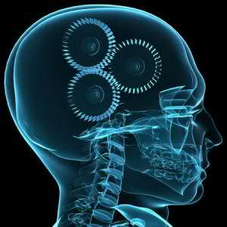
BARRIERS TO CONSIDER
How comfortable are you with hearing “war trauma” if used to working with teenagers who were victims of abuse?
How do you prepare yourself for “new stories”?
Reading suggestions:
We Were Soldiers Once and Young; The Art of War; On Killing: The Psychological Cost of Learning to Kill in War and Society; Military Psychology (CDR Kennedy); The Camouflage Couch and Kevlar for the Mind (Brett Moore)
www.militarypsych.com
Reminder of importance of self-care-How do you take care of yourself?
Notes:
(SHOW SLIDE #2) Vignette “Human Dynamics”
Narrative:
Facilitator Note: Have students discuss small group observations about the Stanford Prison Experiment video
Questions to keep in mind:
How did the video make you feel?
What similarities are there between the Prison Project and the IMT Environment?
Allow the students:
10 Minute Discussion Small Group
5 Minute Large Group Close-Out
Facilitator Note: Break the class down into Small Groups. Have each member of the group discuss their observations about the Stanford Prison Project video, with the focus of linking positions of power and the abuse of power within organizations. Students should be able to identify the similarities between the prison guards and the prisoners in the video. Students can do this by identifying the similarities of power and authority given to each Cadre member over a trainee by position (If students cannot determine similarities, provide them with examples such as Cadre having the power over trainees). Discuss how the video made members of the group feel and why. Consolidate group findings and designate a representative to present the groups findings to the class. Each group will take no more than three minutes to share each group’s feedback.

Slide 41
OVERCOMING BARRIERS
What have you done to become familiar with military terminology ?
Recommended reading:
Army Officers Handbook; The Bluejacket’s Manual; Soldiers Handbook, etc.
Books on local units and their history (82ND Airborne, 10th Mountain, etc.)
What resources are you familiar with that work with military (TAPS, Give an hour, etc.)?
Tragedy Assistance Program (TAPS) volunteers: http://www.taps.org/
Notes:
(SHOW SLIDE #2) Vignette “Human Dynamics”
Narrative:
Facilitator Note: Have students discuss small group observations about the Stanford Prison Experiment video
Questions to keep in mind:
How did the video make you feel?
What similarities are there between the Prison Project and the IMT Environment?
Allow the students:
10 Minute Discussion Small Group
5 Minute Large Group Close-Out
Facilitator Note: Break the class down into Small Groups. Have each member of the group discuss their observations about the Stanford Prison Project video, with the focus of linking positions of power and the abuse of power within organizations. Students should be able to identify the similarities between the prison guards and the prisoners in the video. Students can do this by identifying the similarities of power and authority given to each Cadre member over a trainee by position (If students cannot determine similarities, provide them with examples such as Cadre having the power over trainees). Discuss how the video made members of the group feel and why. Consolidate group findings and designate a representative to present the groups findings to the class. Each group will take no more than three minutes to share each group’s feedback.

Slide 42
POTENTIAL BARRIERS WHICH PREVENT CONNECTING
MOS (Military Occupation Specialty)
Not understanding training and muscle memory- react rather than “think”
Security clearance- different levels (myths and facts)
Don’t want to be judged
Don’t understand how I can’t quit my job or work in another department
We don’t share with others- you wouldn’t understand and I could possibly give YOU nightmares
Mental health and future job opportunities
Not understanding why we get so upset and may not say things (UCMJ)
Nationality- Middle Eastern
Living in two different worlds
YOUR BELIEFS ABOUT PTSD
Notes:
(SHOW SLIDE #2) Vignette “Human Dynamics”
Narrative:
Facilitator Note: Have students discuss small group observations about the Stanford Prison Experiment video
Questions to keep in mind:
How did the video make you feel?
What similarities are there between the Prison Project and the IMT Environment?
Allow the students:
10 Minute Discussion Small Group
5 Minute Large Group Close-Out
Facilitator Note: Break the class down into Small Groups. Have each member of the group discuss their observations about the Stanford Prison Project video, with the focus of linking positions of power and the abuse of power within organizations. Students should be able to identify the similarities between the prison guards and the prisoners in the video. Students can do this by identifying the similarities of power and authority given to each Cadre member over a trainee by position (If students cannot determine similarities, provide them with examples such as Cadre having the power over trainees). Discuss how the video made members of the group feel and why. Consolidate group findings and designate a representative to present the groups findings to the class. Each group will take no more than three minutes to share each group’s feedback.

Slide 43
BARRIERS continued.
Not understanding legal procedures or grievance (SHARP, JAG, IG)
Not understanding ownership (loyalty) toward our brother and sisters in arms- may come before family.
Misdiagnosis could impact career- possibly end it via medical board
Not utilizing evidence based treatment
Potential snags (and pros) by putting vets in groups with non-vets for trauma work
Not familiar with PTSD and mTBI overlapping symptoms
Not familiar with PCL-5
Notes:
(SHOW SLIDE #2) Vignette “Human Dynamics”
Narrative:
Facilitator Note: Have students discuss small group observations about the Stanford Prison Experiment video
Questions to keep in mind:
How did the video make you feel?
What similarities are there between the Prison Project and the IMT Environment?
Allow the students:
10 Minute Discussion Small Group
5 Minute Large Group Close-Out
Facilitator Note: Break the class down into Small Groups. Have each member of the group discuss their observations about the Stanford Prison Project video, with the focus of linking positions of power and the abuse of power within organizations. Students should be able to identify the similarities between the prison guards and the prisoners in the video. Students can do this by identifying the similarities of power and authority given to each Cadre member over a trainee by position (If students cannot determine similarities, provide them with examples such as Cadre having the power over trainees). Discuss how the video made members of the group feel and why. Consolidate group findings and designate a representative to present the groups findings to the class. Each group will take no more than three minutes to share each group’s feedback.

Slide 44
BARRIERS IN THERAPY THE POTENTIAL UGLY ELEPHANT IN THE ROOM….
Disability process, compensation, and VA ratings
Possible Profile
Diagnosis
Medication
Misrepresentation of events while deployed
mTBI – are you familiar with research?
Notes:
(SHOW SLIDE #2) Vignette “Human Dynamics”
Narrative:
Facilitator Note: Have students discuss small group observations about the Stanford Prison Experiment video
Questions to keep in mind:
How did the video make you feel?
What similarities are there between the Prison Project and the IMT Environment?
Allow the students:
10 Minute Discussion Small Group
5 Minute Large Group Close-Out
Facilitator Note: Break the class down into Small Groups. Have each member of the group discuss their observations about the Stanford Prison Project video, with the focus of linking positions of power and the abuse of power within organizations. Students should be able to identify the similarities between the prison guards and the prisoners in the video. Students can do this by identifying the similarities of power and authority given to each Cadre member over a trainee by position (If students cannot determine similarities, provide them with examples such as Cadre having the power over trainees). Discuss how the video made members of the group feel and why. Consolidate group findings and designate a representative to present the groups findings to the class. Each group will take no more than three minutes to share each group’s feedback.

Slide 45
BENEFITS OF BEING A CIVILIAN MENTAL HEALTH PROVIDER
Why did they seek you out?
Consistency
Availability,
Confidentiality,
Stability-not likely to move or go TDY,
Able to be judged “normal” or “diagnosed” by non-military provider
Not seen as expert in their lane so it is ok to say… “walk me through what happened; tell me how you were trained to respond in this type of situation?”
Able to normalize reaction “fight and flight responses”
Acceptance (non biased)
Notes:
(SHOW SLIDE #2) Vignette “Human Dynamics”
Narrative:
Facilitator Note: Have students discuss small group observations about the Stanford Prison Experiment video
Questions to keep in mind:
How did the video make you feel?
What similarities are there between the Prison Project and the IMT Environment?
Allow the students:
10 Minute Discussion Small Group
5 Minute Large Group Close-Out
Facilitator Note: Break the class down into Small Groups. Have each member of the group discuss their observations about the Stanford Prison Project video, with the focus of linking positions of power and the abuse of power within organizations. Students should be able to identify the similarities between the prison guards and the prisoners in the video. Students can do this by identifying the similarities of power and authority given to each Cadre member over a trainee by position (If students cannot determine similarities, provide them with examples such as Cadre having the power over trainees). Discuss how the video made members of the group feel and why. Consolidate group findings and designate a representative to present the groups findings to the class. Each group will take no more than three minutes to share each group’s feedback.

Slide 46
BENEFITS
Connections with community resources and guidance for possible career changes
Don’t want others to know they need help
Usually patient care is provided by entry level clinicians -- CPT or 1LT social worker
Have many providers due to frequent relocations (TDY, PCS etc.)
Higher rank may intimidate (LTC, COL, etc.)
Notes:
(SHOW SLIDE #2) Vignette “Human Dynamics”
Narrative:
Facilitator Note: Have students discuss small group observations about the Stanford Prison Experiment video
Questions to keep in mind:
How did the video make you feel?
What similarities are there between the Prison Project and the IMT Environment?
Allow the students:
10 Minute Discussion Small Group
5 Minute Large Group Close-Out
Facilitator Note: Break the class down into Small Groups. Have each member of the group discuss their observations about the Stanford Prison Project video, with the focus of linking positions of power and the abuse of power within organizations. Students should be able to identify the similarities between the prison guards and the prisoners in the video. Students can do this by identifying the similarities of power and authority given to each Cadre member over a trainee by position (If students cannot determine similarities, provide them with examples such as Cadre having the power over trainees). Discuss how the video made members of the group feel and why. Consolidate group findings and designate a representative to present the groups findings to the class. Each group will take no more than three minutes to share each group’s feedback.

Slide 47
Benefits of being an Adlerian Provider
Sense of hope and encouragement
Look for strengths and resiliency
Have a respect for struggles
Understand the need to belong and sense of purpose
Endorse the 4 C’s (Connect, Capable, Count, and Courage)
PTSD work- understand core beliefs (moral injury)
Advocate for Service Members

Slide 48
What Service Members will mostly present with at your clinic
Adjustment Disorders * Mood Disorders
Occupational Stress * Substance Abuse
Marital issues (feeling detached/ not belonging)
PTSD/ Anxiety NOS
Sleep issues
Chronic pain issues
Being separated from the military
Difficulties with Life Tasks

Slide 49
INTERESTED IN WORKING WITH MILITARY SERVICE MEMBERS
Where are the nearest military establishments?
Give an Hour. Org
How to become a “Tri-Care” provider
Military One Source
Military and Family Life Counselors
GS positions (usajobs.gov)
Notes:
(SHOW SLIDE #2) Vignette “Human Dynamics”
Narrative:
Facilitator Note: Have students discuss small group observations about the Stanford Prison Experiment video
Questions to keep in mind:
How did the video make you feel?
What similarities are there between the Prison Project and the IMT Environment?
Allow the students:
10 Minute Discussion Small Group
5 Minute Large Group Close-Out
Facilitator Note: Break the class down into Small Groups. Have each member of the group discuss their observations about the Stanford Prison Project video, with the focus of linking positions of power and the abuse of power within organizations. Students should be able to identify the similarities between the prison guards and the prisoners in the video. Students can do this by identifying the similarities of power and authority given to each Cadre member over a trainee by position (If students cannot determine similarities, provide them with examples such as Cadre having the power over trainees). Discuss how the video made members of the group feel and why. Consolidate group findings and designate a representative to present the groups findings to the class. Each group will take no more than three minutes to share each group’s feedback.

Slide 50
DEPARTMENT OF DEFENST TOOLS
Evidence based techniques
PTSD Coach
PE Coach
Tactical Breathing
Virtual Hope Box
Breathe 2 Relax moving Forward
STAR- CBT-I
Center for Deployment Psychology
Notes:
(SHOW SLIDE #2) Vignette “Human Dynamics”
Narrative:
Facilitator Note: Have students discuss small group observations about the Stanford Prison Experiment video
Questions to keep in mind:
How did the video make you feel?
What similarities are there between the Prison Project and the IMT Environment?
Allow the students:
10 Minute Discussion Small Group
5 Minute Large Group Close-Out
Facilitator Note: Break the class down into Small Groups. Have each member of the group discuss their observations about the Stanford Prison Project video, with the focus of linking positions of power and the abuse of power within organizations. Students should be able to identify the similarities between the prison guards and the prisoners in the video. Students can do this by identifying the similarities of power and authority given to each Cadre member over a trainee by position (If students cannot determine similarities, provide them with examples such as Cadre having the power over trainees). Discuss how the video made members of the group feel and why. Consolidate group findings and designate a representative to present the groups findings to the class. Each group will take no more than three minutes to share each group’s feedback.

Slide 51
QUESTIONS?
Notes:
(SHOW SLIDE #2) Vignette “Human Dynamics”
Narrative:
Facilitator Note: Have students discuss small group observations about the Stanford Prison Experiment video
Questions to keep in mind:
How did the video make you feel?
What similarities are there between the Prison Project and the IMT Environment?
Allow the students:
10 Minute Discussion Small Group
5 Minute Large Group Close-Out
Facilitator Note: Break the class down into Small Groups. Have each member of the group discuss their observations about the Stanford Prison Project video, with the focus of linking positions of power and the abuse of power within organizations. Students should be able to identify the similarities between the prison guards and the prisoners in the video. Students can do this by identifying the similarities of power and authority given to each Cadre member over a trainee by position (If students cannot determine similarities, provide them with examples such as Cadre having the power over trainees). Discuss how the video made members of the group feel and why. Consolidate group findings and designate a representative to present the groups findings to the class. Each group will take no more than three minutes to share each group’s feedback.

Slide 52
Notes:
(SHOW SLIDE #3) Terminal Learning Objective
Take a moment to read the TLO:
The following actions, conditions and standards will enable us to gain an understanding of the Behavioral Drift and its impact in the IMT environment.
Action: Identify Behavioral Drift
Condition: In a classroom environment, given TRADOC Regulation 350-6, an open forum on Behavioral Drift, procedures, administrative guidance, PowerPoint presentation, Turning Technologies Clicker, iPad and a Facilitator
Standard: Demonstrate a greater understanding of how Cadre and Trainees can give in to Behavioral Drifts in the IMT environment.

Slide 53
Notes:
(SHOW SLIDE #3) Terminal Learning Objective
Take a moment to read the TLO:
The following actions, conditions and standards will enable us to gain an understanding of the Behavioral Drift and its impact in the IMT environment.
Action: Identify Behavioral Drift
Condition: In a classroom environment, given TRADOC Regulation 350-6, an open forum on Behavioral Drift, procedures, administrative guidance, PowerPoint presentation, Turning Technologies Clicker, iPad and a Facilitator
Standard: Demonstrate a greater understanding of how Cadre and Trainees can give in to Behavioral Drifts in the IMT environment.

Slide 54
Notes:
(SHOW SLIDE #3) Terminal Learning Objective
Take a moment to read the TLO:
The following actions, conditions and standards will enable us to gain an understanding of the Behavioral Drift and its impact in the IMT environment.
Action: Identify Behavioral Drift
Condition: In a classroom environment, given TRADOC Regulation 350-6, an open forum on Behavioral Drift, procedures, administrative guidance, PowerPoint presentation, Turning Technologies Clicker, iPad and a Facilitator
Standard: Demonstrate a greater understanding of how Cadre and Trainees can give in to Behavioral Drifts in the IMT environment.

Slide 56
RESOURCES
Yellow Ribbon: http://www.yellowribbon.mil/yrrp/
Strong Bonds
Center for Deployment Psychology
Military One Source (http://www.militaryonesource.mil/) free products
www.focusproject.org/resources
http://csf2.army.mil/resilience-training.html
www.familiesnearandfar.org
www.couragetotalk.org
www.sesamestreet.org/parents/topicsandactivites/toolkits/tlc
Notes:
(SHOW SLIDE #2) Vignette “Human Dynamics”
Narrative:
Facilitator Note: Have students discuss small group observations about the Stanford Prison Experiment video
Questions to keep in mind:
How did the video make you feel?
What similarities are there between the Prison Project and the IMT Environment?
Allow the students:
10 Minute Discussion Small Group
5 Minute Large Group Close-Out
Facilitator Note: Break the class down into Small Groups. Have each member of the group discuss their observations about the Stanford Prison Project video, with the focus of linking positions of power and the abuse of power within organizations. Students should be able to identify the similarities between the prison guards and the prisoners in the video. Students can do this by identifying the similarities of power and authority given to each Cadre member over a trainee by position (If students cannot determine similarities, provide them with examples such as Cadre having the power over trainees). Discuss how the video made members of the group feel and why. Consolidate group findings and designate a representative to present the groups findings to the class. Each group will take no more than three minutes to share each group’s feedback.

Slide 57
Sources
Advances in Social Work Vol. 13 No 1 (Spring 2012): Promoting Military Cultural Awareness in Off Post Community of Behavioral Health and Social Support Services Providers (Christi Luby)
Returning home: What we know about reintegration of deployed service members into their families and communities (https://www.ncfr.org/ncfr-report/focus/military-families/returning-home

